Slide 1
EDUVISION DV
Higher-Education Analytics & Tableau Dashboard Suite
Internship Project
Kamalesh Debnath
Infosys Springboard
QS World University Rankings 2026 × Times Higher Education data
Final integrated dataset: 1,120 universities | 93 countries | 50 fields
2026
Notes:
Slide transition: Fade. Build order: title → primary content → supporting details.

Slide 2
Project Chronology
Completed workflow aligned with the eight project modules in the HEP plan.
Weeks 1–2
01 Data Collection
Weeks 1–2
02 Cleaning & Transformation
QS + THE datasets collected; performance indicators assembled.
Duplicates removed; university/country names standardized; ranking metrics normalized.
Weeks 3–4
03 KPI Engineering
Weeks 3–4
04 Planning & Prototype
Six education KPIs calculated and prepared for Tableau.
Four dashboard layouts, filters, navigation and actions defined.
Weeks 5–6
05 University + Research
Weeks 5–6
06 Student + Country
Overview and Research Analytics dashboards built and validated.
Student Analytics and Country Comparison integrated with global controls.
Weeks 7–8
07 Testing & Validation
Weeks 7–8
08 Documentation & Delivery
KPI, ranking, interaction and educational-metric checks performed.
Final workbook, documentation, QA material and delivery structure completed.
Outcome: a single integrated Tableau workbook rather than separate analytical outputs.
Notes:
Slide transition: Fade. Build order: title → primary content → supporting details.

Slide 3
Data Foundation & Integration
The project moved from two ranking sources to one Tableau-ready analytical structure.
QS World University Rankings 2026
Cleaning, Standardization & Integration
1,501 universities
30 source columns
• Remove duplicate records
• Standardize university names and country names
• Normalize ranking metrics to a common analytical basis
• Integrate matching university records
• Create the final Tableau-ready structure
Times Higher Education data
16,713 records
2016–2026 coverage
FINAL 2026 MERGED DATASET
1,120 universities | 93 countries | 50 fields
Project deliverables included university_raw_data.csv, data_collection.py, university_cleaned.csv, education_cleaning.ipynb and the final KPI dataset.
Notes:
Slide transition: Fade. Build order: title → primary content → supporting details.

Slide 4
KPI Engineering
Six engineered indicators converted ranking and institutional measures into decision-support metrics.
Global Ranking Score
Research Impact Score
Average of normalized QS and THE rank scores
35% Citations per Faculty + 45% THE Research Quality + 20% Industry Impact
Faculty-to-Student Ratio
International Student Percentage
1 / Students-to-Staff Ratio
International Students × 100
Academic Reputation Score
Research Productivity Index
QS Academic Reputation Score
30% Research Quality + 25% Research Environment + 20% Citations per Faculty + 15% International Research Network + 10% Industry Impact
Engineering principle: combine complementary indicators so the dashboard can move beyond a single rank and support multidimensional comparisons.
Notes:
Slide transition: Fade. Build order: title → primary content → supporting details.

Slide 5
Tableau Development & Dashboard Integration
The final workbook connected 52 analytical worksheets through shared controls and calculated logic.
Worksheets
Global Filters
Parameters
52 analytical worksheets feeding four dashboards
Year, Region, Country, Focus, Research, Size, Status
Metric selection and user-driven analytical views
Calculated Fields
Dashboard Actions
Reset Controls
KPI calculations, ranking movement and derived measures
Navigation, comparisons and interactive selections
Reset-filter controls for consistent exploration
Integrated outcome
Four interconnected dashboards: University Overview → Research Analytics → Student Analytics → Country Comparison
The HEP project plan records successful dashboard integration with navigation and filters functioning correctly.
Notes:
Slide transition: Fade. Build order: title → primary content → supporting details.

Slide 6
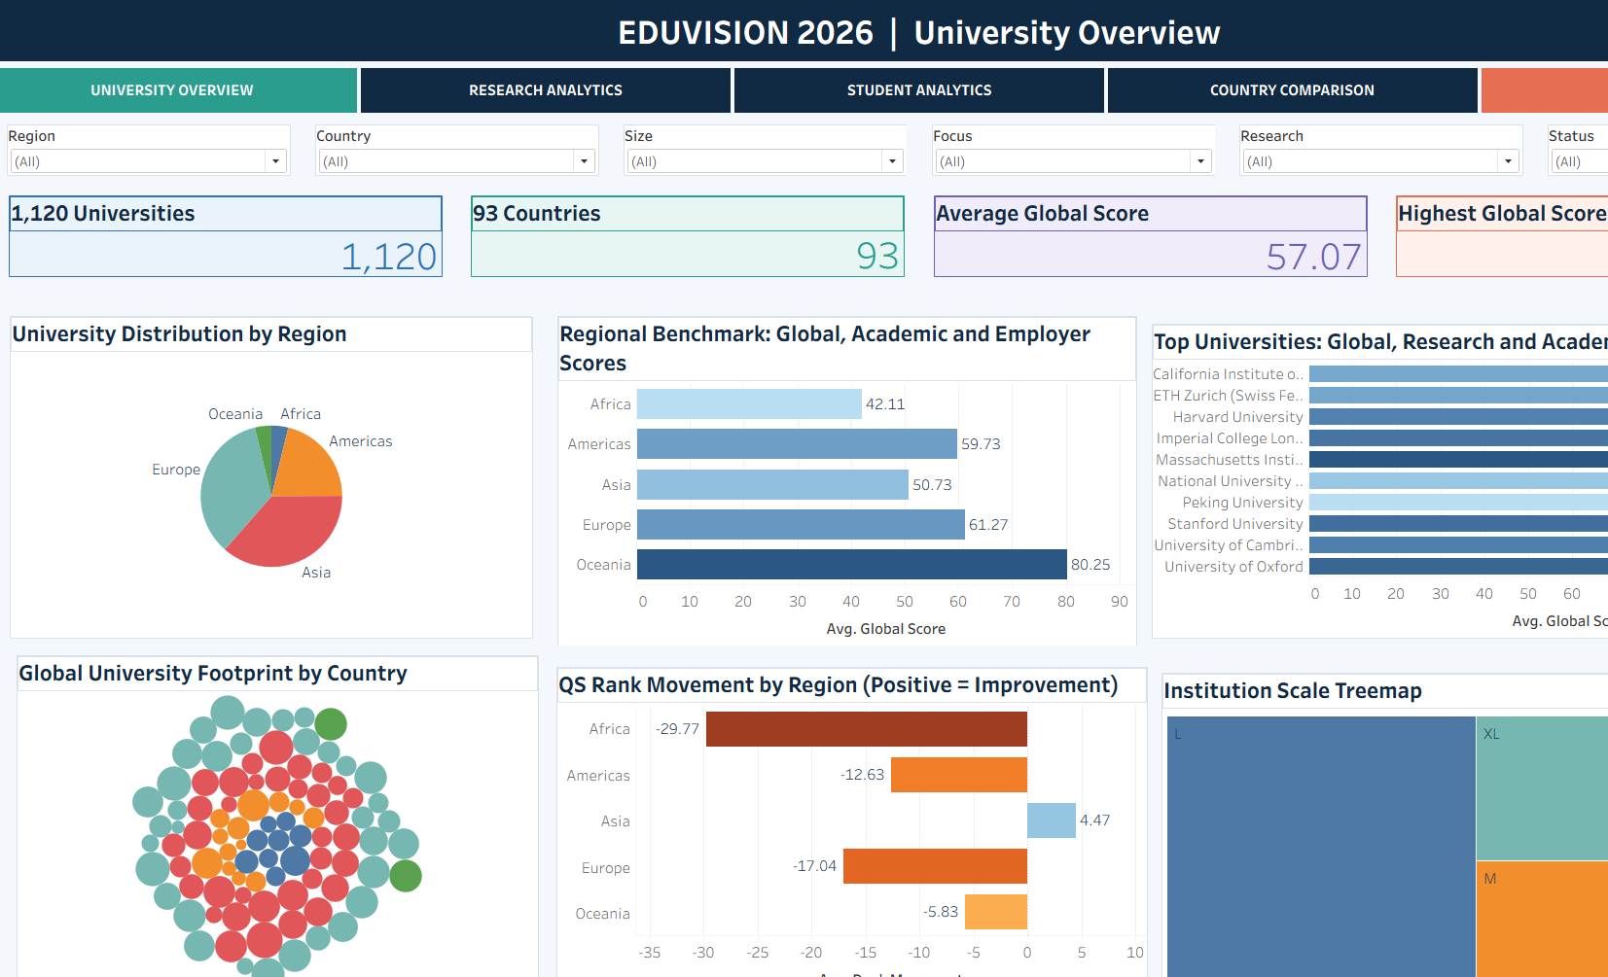
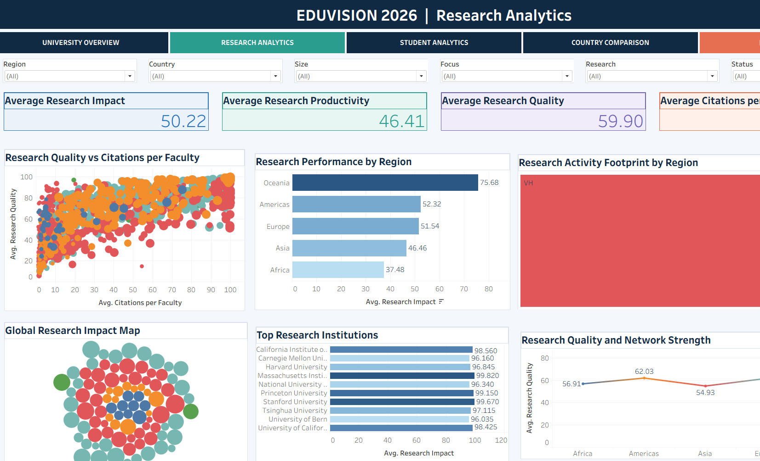
Dashboard Output: University Overview & Research Analytics
The completed dashboards present the core institutional, regional and research views used in the project.
Notes:
Slide transition: Fade. Build order: title → primary content → supporting details.

Slide 7
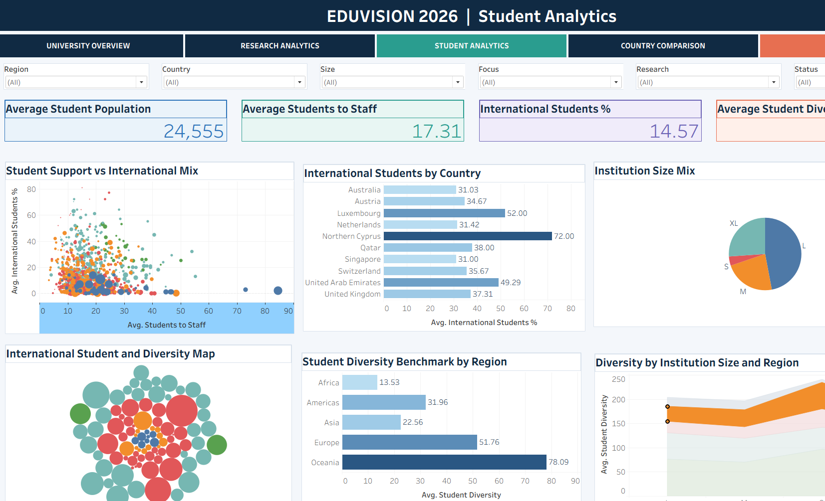
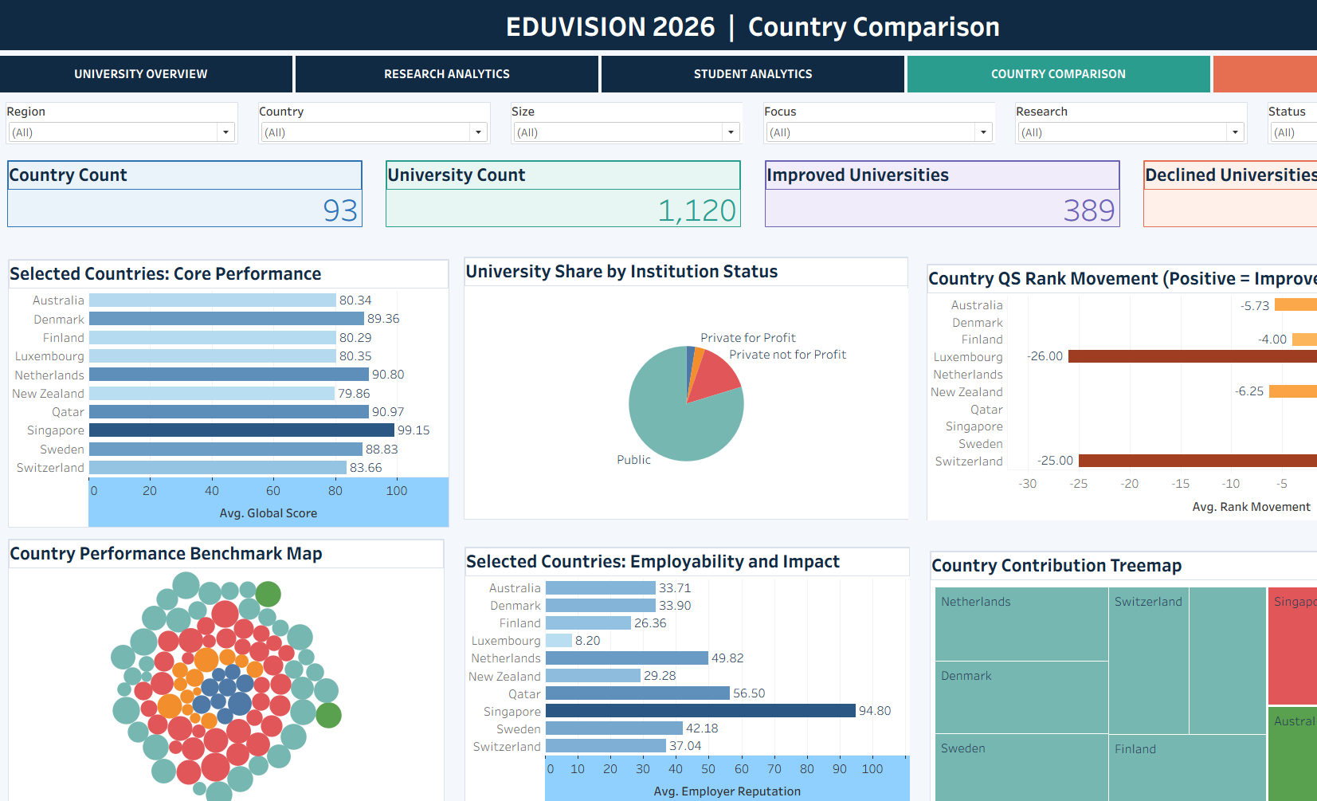
Dashboard Output: Student Analytics & Country Comparison
Student composition, internationalization, country benchmarking and rank movement are brought into the same analytical interface.
Notes:
Slide transition: Fade. Build order: title → primary content → supporting details.

Slide 8
Testing, Validation & Project Completion
Module 7 and Module 8 closed the project with validation, documentation and delivery.
KPI validation
Verified six engineered KPI calculations.
COMPLETED DELIVERABLE
Final EduVision_DV Tableau packaged workbook
Four integrated dashboards
52 analytical worksheets
Global filters, parameters, actions and reset controls
Documented testing and delivery structure
Ranking validation
Checked normalized ranking and rank-movement calculations.
Interaction testing
Tested filters, parameters, dashboard actions, navigation and reset controls.
Educational metrics
Validated the intended analytical measures and dashboard outputs.
Project status
COMPLETED
The project plan records the expected final evaluation as KPI accuracy above 95% and no major dashboard issues; these are project-plan evaluation targets, not independent re-measurements in this presentation.
Notes:
Slide transition: Fade. Build order: title → primary content → supporting details.

